Slide 1
Semantic Web Ontologies Pertaining to
Heterogeneity and Social Networks
Daniela Martignani
Peter Miele
Jennifer Shaska

Slide 2
Overview
Introduction to Semantic Web
Background of Data Formats
Ontology Comparison and Merging
Social Networks
Conclusion

Slide 3
Introduction
Semantic web provides a means to query and infer knowledge from existing information
Provides a structure to data for machine processing that existing data does not provide
Semantic web has a variety of data formats with a few that are widely used
Multiple actors working independently leads to needing to merge different islands of information
Social Networks provide a complex problem as the definitions of resources is not as well defined as that of language

Slide 4
Background of Data Formats
RDF Schema (RDFs) extends RDF, by including the notion of classes and subclasses.
Domains and ranges of properties are used to connect classes and properties.

Slide 5
Background of Data Formats
OWL (Web Ontology Language) adds constructs of Description Logics to RDF, which allow for greater expressiveness in characterizing classes and properties.
OWL is really a set of three languages with increasing expressiveness: OWLLite, OWLDL, OWL Full

Slide 6
Background of Data Formats
Comparisons of Ontology language tools to other tools used to help groups understand things in the same way as each other
UML
Lots of overlap between UML and RDF(s)/OWL
UML has smaller scope - just objects and their roles in an OO system
Does not have disjointness, union, intersection, and equivalence of classes
Entity/Relationship modelling
Generalizations of properties not allowed in E/R modelling like in RDF(s)/OWL (ex: subPropertyOf)
RDF/OWL can not handle composite keys like E/R modelling

Slide 7
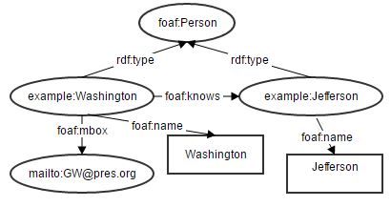
Background of Data Formats
@prefix rdfs: < http://www.w3.org/2000/01/rdf-schema\#label> .
@prefix rdf: < http://www.w3.org/1999/02/22-rdf-syntax-ns> .
@prefix ex: < http://www.example.org/> .
@prefix foaf: < http://xmlns.com/foaf/0.1/> .
ex:Washington rdf:type foaf:Person .
ex:Jefferson rdf:type foaf:Person .
ex:Washington foaf:name "Washington" .
ex:Washington foaf:knows example:Jefferson .
ex:Washington foaf:mbox < mailto:GW@pres.org> .
ex:Jefferson foaf:name "Jefferson" .

Slide 8
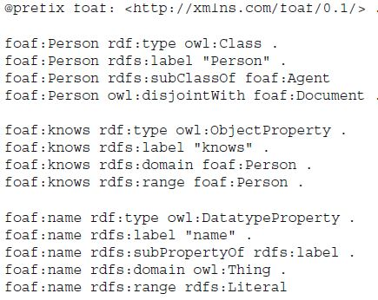
Some Friend-of-a-Friend vocabulary used in previous example:

Slide 9
Ontology Comparison and Merging
Semantic Ambiguity: many intended meanings are associated with the same word
Semantic Redundancy: many semantic descriptions are available to represent the same intended meaning

Slide 10
Ontology Comparison and Merging
Ontology Matching
Extract context and compute similarities between ontologies
Sense Clustering
Compute a similarity between each ontology term
Combine by clustering the two terms with the highest similarity, then recompute similarities
Sense Disambiguation
Discover context of sense cluster and of query
Determine similarity between sense cluster and query
The highest scoring sense cluster is likely the candidate we want

Slide 11
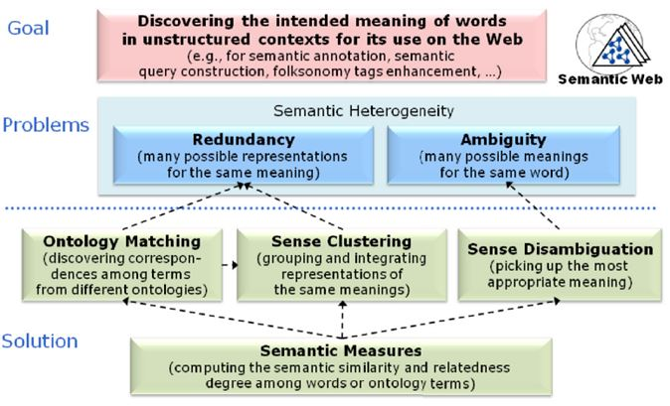
Ontology Comparison and Merging

Slide 12
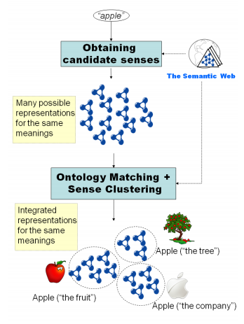
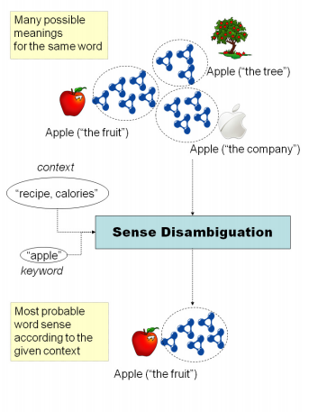
Ontology Comparison and Merging
Give me a list, ordered by calories, of
recipes containing apple

Slide 13
Ontologies in Social Networks
Currently, there are not any established framework that aggregate ontologies
No efforts have been done in inter-linking different social network sites
Main challenge of social networks: data inconsistency and multiple accounts for same user to link

Slide 14
Ontologies in Social Networks
Semantic Web: technology to make social web sites more connected and to gain more interoperability through metadata creation and inter-connected vocabularies
Use Ontologies as tools to analyze and extract relationships among web sites
Goal: build a framework to create interconnection among multiple social networks by aggregating ontologies

Slide 15
Ontologies to use for Social Networks
Dublin Core (DC): A system combining fifteen elements that are used to describe resources
Example: DC element Title describes a name gives to a resource

Slide 16
Ontologies to use for Social Networks
Semantically-Interlinked Online Communities (SIOC): open-standard machine readable format to extract metadata useful for semantic browsing, content management and social web
Example: class sioc:Post describes/identifies an article or message that can be posted to a Forum or social network site

Slide 17
Example of both DC and SIOC
<sioc:Post rdf:about="http://johnbreslin.com/blog/2006/09/07/creating-connections-between-discussion-clouds-with-sioc/"> <dc:title>Creating connections between discussion clouds with SIOC</dc:title> <dcterms:created>2006-09-07T09:33:30Z</dcterms:created> <sioc:has_container rdf:resource="http://johnbreslin.com/blog/index.php?sioc_type=site#weblog"/> <sioc:has_creator> <sioc:User rdf:about="http://johnbreslin.com/blog/author/cloud/" rdfs:label="Cloud"> <rdfs:seeAlso rdf:resource="http://johnbreslin.com/blog/index.php?sioc_type=user&amp;sioc_id=1"/> </sioc:User> </sioc:has_creator> <sioc:content>SIOC provides a unified vocabulary for content and interaction description: a semantic layer that can co-exist with existing discussion platforms.</sioc:content> <sioc:topic rdfs:label="Semantic Web" rdf:resource="http://johnbreslin.com/blog/category/semantic-web/"/> <sioc:topic rdfs:label="Blogs" rdf:resource="http://johnbreslin.com/blog/category/blogs/"/> <sioc:has_reply> <sioc:Post rdf:about="http://johnbreslin.com/blog/2006/09/07/creating-connections-between-discussion-clouds-with-sioc/#comment-123928"> <rdfs:seeAlso rdf:resource="http://johnbreslin.com/blog/index.php?sioc_type=comment&amp;sioc_id=123928"/> </sioc:Post> </sioc:has_reply> </sioc:Post>

Slide 18
Ontologies to use for Social Networks
Friend-of-a-Friend (FOAF): ontology built on top of a RDF based schema to semantically express individuals and their social networks
Example: class foaf:Person identifies an online user and has properties describing his information
<foaf:Person>
<foaf:name>Peter Parker</foaf:name>
<foaf:mbox_sha1sum>cf2f4bd069302febd8d7c26d803f63fa7f20bd82</foaf:mbox_sha1sum>
</foaf:Person>
<foaf:Person>
<foaf:name>Spiderman</foaf:name>
<foaf:mbox_sha1sum>cf2f4bd069302febd8d7c26d803f63fa7f20bd82</foaf:mbox_sha1sum>
</foaf:Person>

Slide 19
Ontologies to use for Social Networks
Simple Knowledge Organization System (SKOS): captures organizational knowledge provided in RDF documents, extracts similarities and enables technology and information sharing among organization systems
Example: skos:Concept URI describes a SKOS concept that can be viewed as an idea
<MyConcept> rdf:type skos:Concept , owl:Class (<MyConcept> is an instance of skos:Concept and an instance of owl:Class)

Slide 20
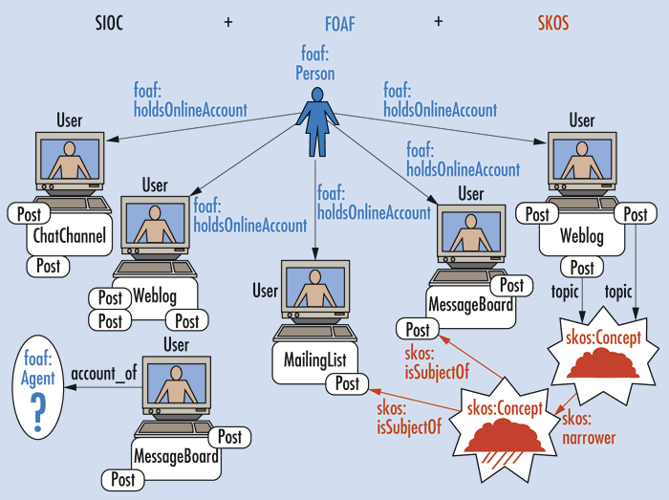
Interconnecting the Ontologies for a Framework

Slide 21
Conclusion
An interconnected web of social networks will someday exist
This will allow querying a user rather than a specific social network
Data formats, tools to create, and tools to utilize them are all evolving to provide easier access to data creation and consumption
Dealing with multiple independent actors defining data is still an ongoing concern

Slide 22
Sources
Social Networks and the Semantic Web, vol. 5 of Semantic Web and Beyond. Boston, MA: Springer US, 2007.
“FOAF Vocabulary Specification.” http://xmlns.com/foaf/spec/20140114.html[Accessed 2016-03-26].
J. Gracia and E. Mena, “Dealing with Semantic Heterogeneity Issues on the Web,” IEEE Internet Computing, 2011.
M. Jamalzadeh and N. Behravan, “Using semantic web ontologies for better inter-operability on social network sites,” in Control
System, Computing and Engineering (ICCSCE), 2011 IEEE International Conference on, pp. 103–108, Nov 2011.
“SKOS Simple Knowledge Organization System Reference.” https://www.w3.org/TR/2009/REC-skos-reference-20090818/[Accessed 2016-03-26].
“SIOC Core Ontology Specification.” https://www.w3.org/Submission/sioc-spec/[Accessed 2016-03-26].
“DCMI Home: Dublin Core Metadata Initiative (DCMI).” http://dublincore.org/[Accessed 2016-03-26].
“An Introduction to FOAF,” An Introduction to FOAF, 04-Feb-2004. [Online]. Available at: http://www.xml.com/pub/a/2004/02/04/foaf.html. [Accessed: 02-Apr-2016].

